Slide 1
SoftUni Fighter
Team Petra

Slide 2
Team Petra
Alexander Apostolov
Konstantin Severy
Ivaylo Vachev
Gabriel Belchev

Slide 3
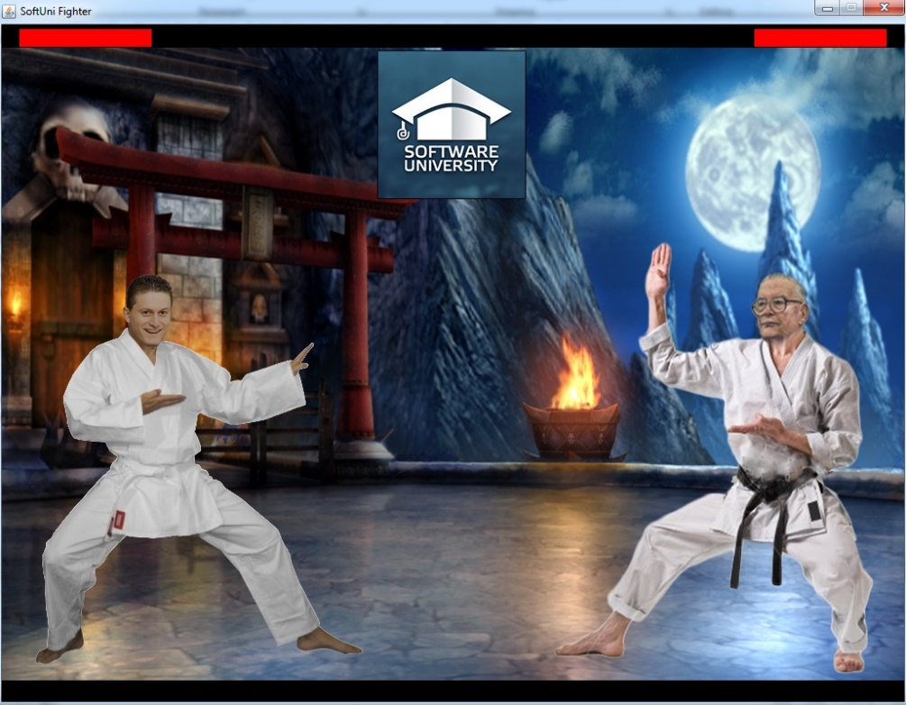
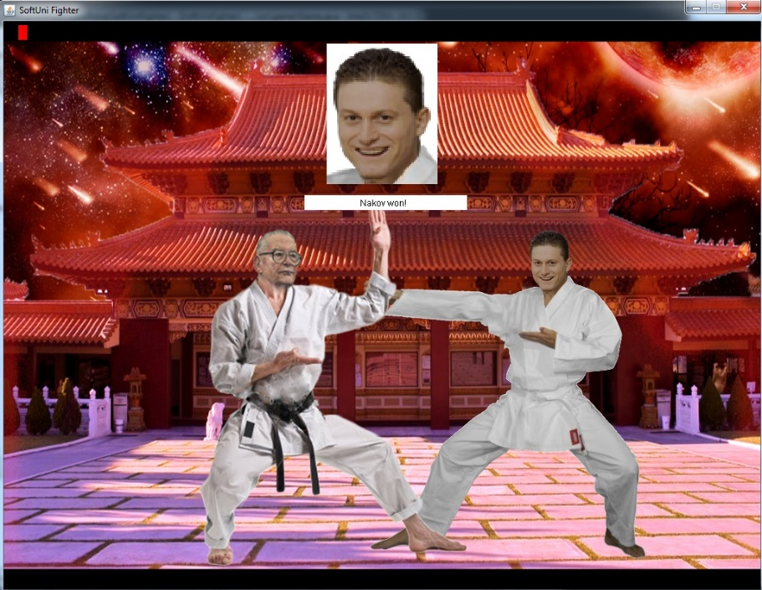
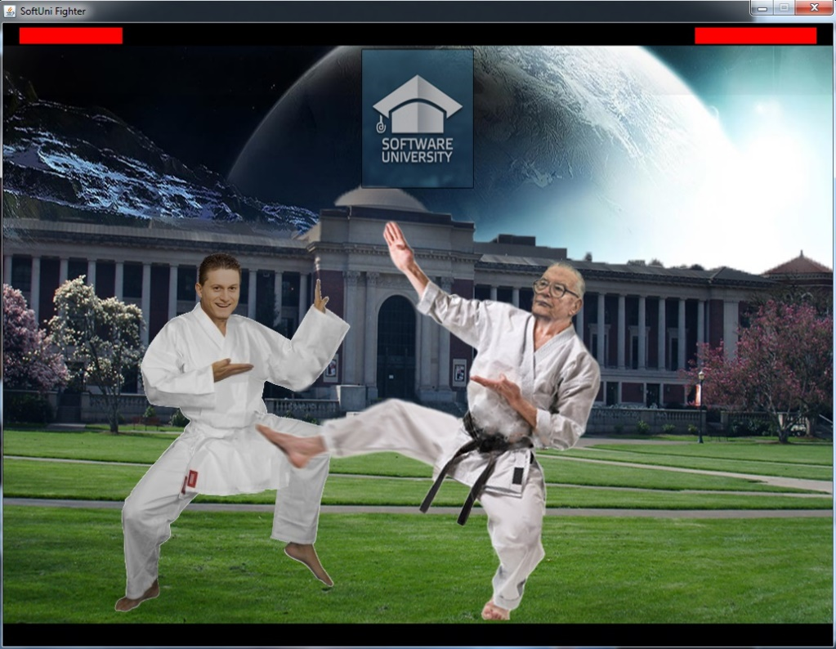
SoftUni Figther
Idea
Game features
Outcome

Slide 4
Contribution
Ivaylo Vachev
Idea
Character sprites
Background images
Music
Alexander Apostolov
Movement and attack logic
Animations
Controls
Background randomization
Konstantin Severy
Bounding boxes and collision
Turning
Blocking logic
Music

Slide 5
Thank you for your attention ☺

